Slide 1
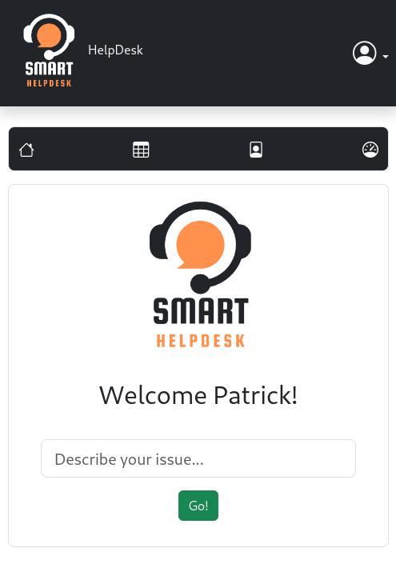

Smart Help Desk System
Project Introduction for BSc (Hons) in Contemporary Software Development, 2022/2023
Patrick Pulfer
L00177585
Patrick Pulfer, Student L00177585 at ATU
May 2023

Slide 2
Agenda
Introduction and Background
Purpose of the Project, Aims & Objectives
Design & Methodology
Implementation
Testing
Conclusion
Demo
Patrick Pulfer, Student L00177585 at ATU
May 2023

Slide 3
Introduction and Background
What is a Help Desk system?
In this day and age Help Desk is often referred as a person or department that provides assistance and information for electronic or computer problems (Merriam-Webster, 2021).
During digital transformation, companies became the prominent driver for social change and economic growth (Brynjolfsson and Kahin, 2002).
In a 2022 survey conducted by Statista, worldwide retail e-commerce projected sales were forecasted to reach about 8.1 trillion US dollars by 2026, a 56% per cent increase from the 5.2 trillion US dollars worldwide in 2022 (Statista, 2022).
The traditional Help Desk system
We have all interacted with Help Desk systems throughout our lives and certainly experienced positive and negative interactions. Throughout my career in IT, I have personally experienced frustration with existing systems that could be categorised as the following:
Slow response
No resolution steps for previously resolved issues
I was unaware of maintenances or known disturbances after the agent advised of such

Slide 4
Introduction and Background
Evolution of Help Desk systems
As companies were forced to innovate through digital transformation to remain competitive, so did the Help Desk systems. As a result, a modern Help Desk system is no longer seen as a technical problem fixer but as a strategic tool and advisory in direct involvement and decision-making in development (Pancucci, 1995).
It has been proven in several studies that a modern Help Desk service provides several benefits if implemented correctly. In some companies, the benefits have translated into fewer technical issues, reduced technical costs and increased overall employee satisfaction (Firmansyah and Subriadi, 2022).
In agreement with previous studies (Wangenheim et al., 2007), an empirical study of the impact of employee satisfaction conducted in 2020 found evidence that employee job satisfaction has a significant effect on customer satisfaction (Kurdi, Alshurideh and Alnaser, 2020).
As noted earlier, digital transformation encouraged companies to innovate, and this effect was also seen in how Help Desks were perceived in modern companies.

Slide 5
Purpose of the Project, Aims & Objectives
This project aims to develop a smarter Help Desk online system to improve the end-user experience, lower costs in human resources and improve metrics like Time to Resolution (TTR).
The system will automate troubleshooting steps to gather diagnostic data, make this data available for the Help Desk engineer and suggest possible solutions proactively.
As noted earlier, digital transformation encouraged companies to innovate, and this effect was also seen in how Help Desks were perceived in modern companies.
Objectives
To evaluate APIs or Endpoints which can provide data and answer the following questions:
Is the service/system down?
Is the service/system accessible?
Is a specific component of the system accessible or experiencing a fault?
To identify diagnostic data which can be relevant in suggesting troubleshooting steps.
To identify measures of success.
To identify technologies needed to create a satisfying user experience by developing a responsive web application in HTML, CSS, JavaScript, Python and Databases.

Slide 6
Functional and non-functional requirements
Use-Cases and Technical Design
Gathering User Stories as functional requirements was the first step to understanding the project's scope.
The requirements for the Smart Diagnostics report were also explored for the selected third-party provider.
Security, Reliability, Usability and Scalability were also explored to scope the project.
Software and Hardware requirements were explored by asking questions such as "Does this app need to be available 24/7 ?" and "Does it need to be available on any device, anywhere?"
Use-case diagrams and use-case primary and alternative flows and flow of events diagrams were explored, using Agile methodology.
Design & Methodology

Slide 7
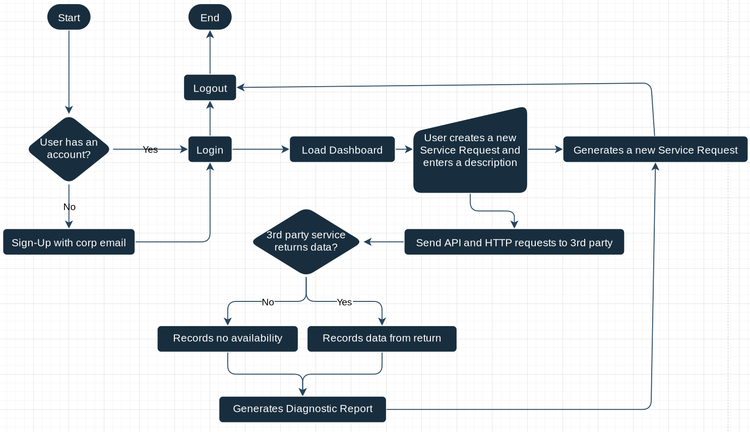
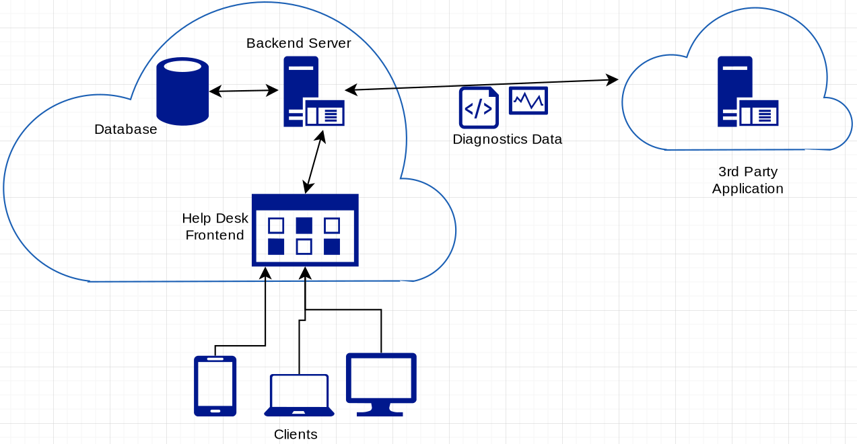
Design & Methodology
Architecture Design Diagram
Flow Chart events from end-user perspective

Slide 8
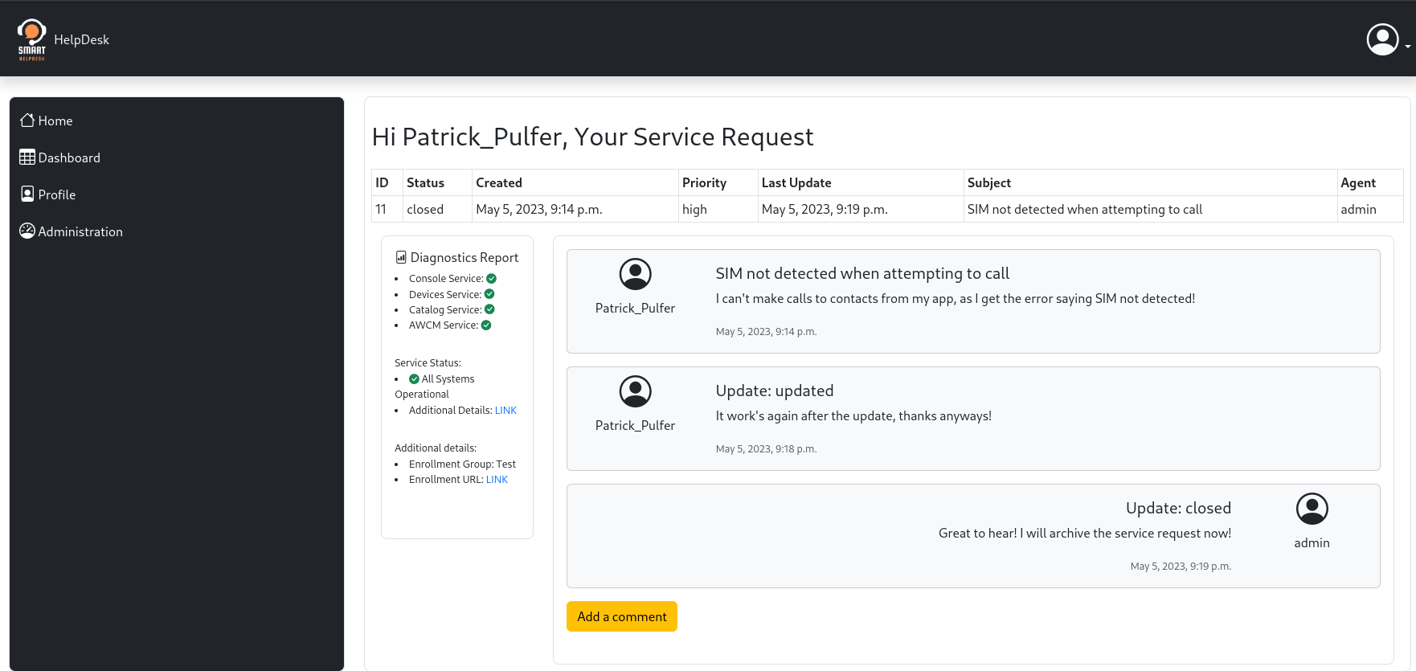
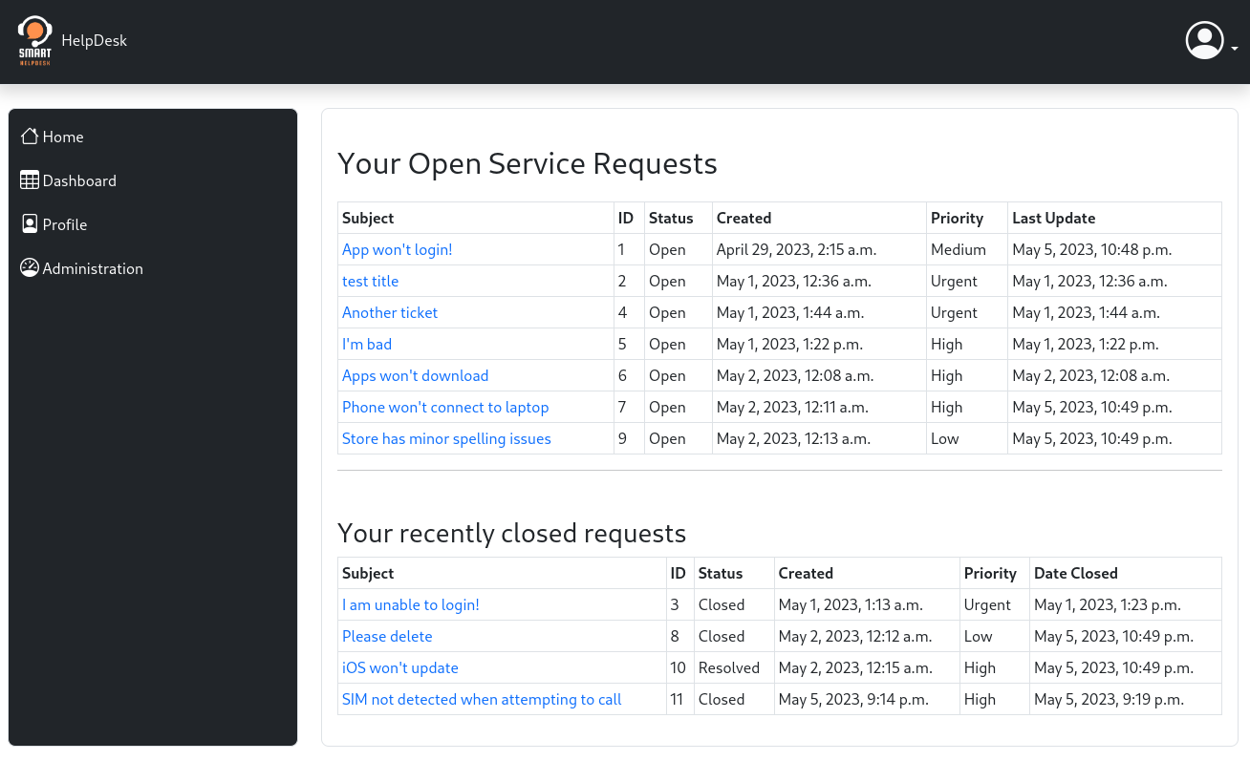
Design & Methodology
Desktop
Tablet
Phone

Slide 9
Implementation - Technologies Used
What combination of software “pieces” are required to achieve our goal?
Website as interface
Django framework, Python
Bootstrap UI toolkit
SQL Relational Database
Selenium WebDriver
Modular System Design

Slide 10
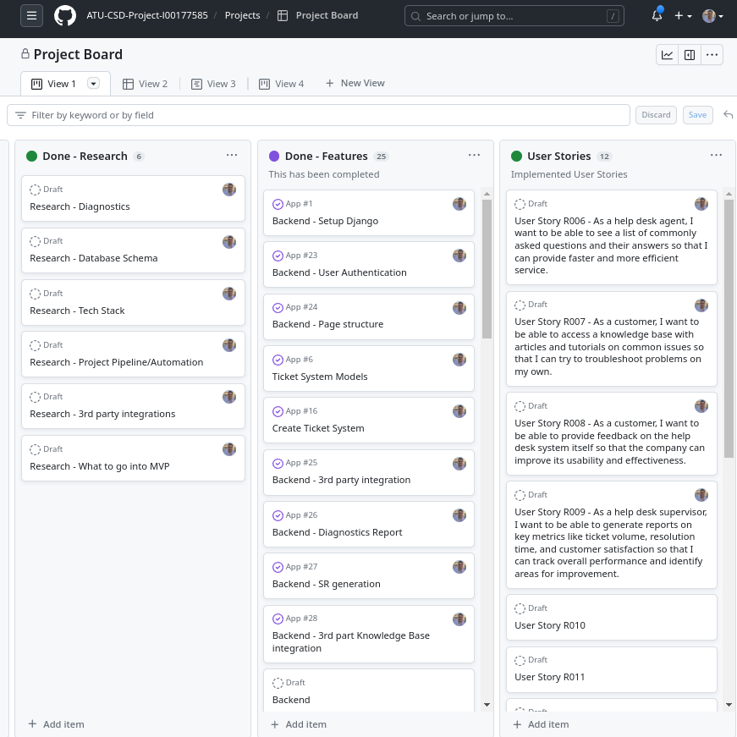
Project Management for Implementation
GitHub Projects, Actions and Code Repository
GitHub was the platform selected for the Project Management, Automated Pipeline and Software Version Control due to it’s excellent integration and ease of use.
Software Version control is a system that manages changes to source code files, documentation and other project-related assets. Tracking, reviewing, reverting modifications and backup code to avoid data loss were ideal use cases for this project's scope.

Slide 11
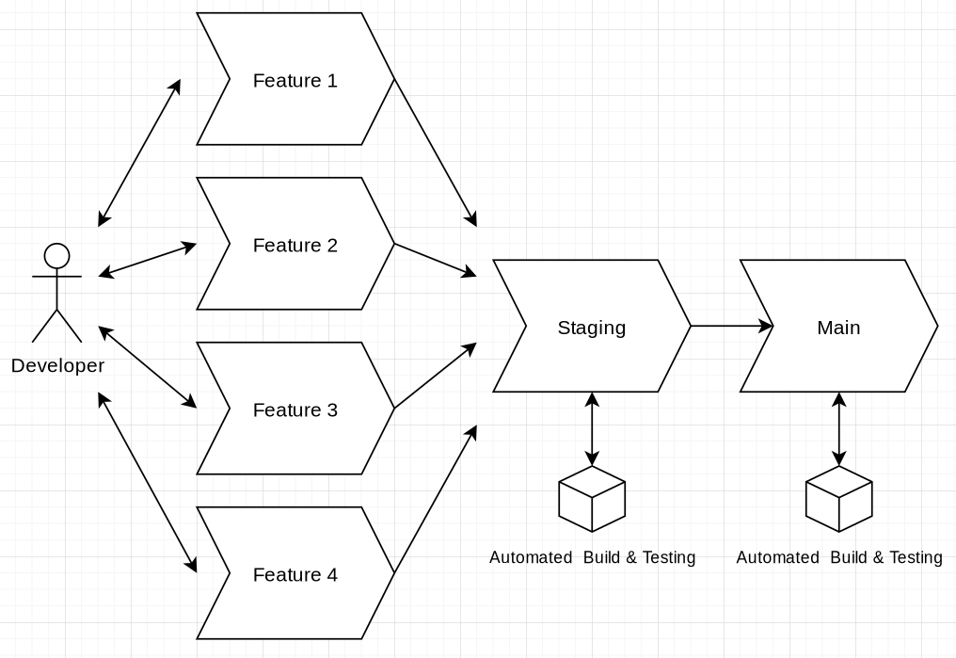
Testing
Instructed Step by Step testing
Automated Tests
Step-by-step instructions for testing have been designed for each user story to ensure the project's scope is appropriate.
Django Unit tests were written to test the planned HTTP requests to ensure availability and expected responses. If any of the following tests fail in the future, we can expect that the third-party provider has made changes, and the application will have to adapt to those changes.
Automated Tests performed on Code Merge

Slide 12
Conclusion
In this proposal, I have outlined a comprehensive plan for developing the envisioned Smart Help Desk project, underscored its purpose and feasibility, and delineated its potential for driving efficiency and competitive advantage.
Limitations (opportunities for future releases/iterations)
Significant learnings have been made while drafting this report and implementing the additional skills learned through the study.
A well-structured purpose and requirements chapter has immensely benefited the vision of code implementation, as well as avoiding the scope creep.
The current third-party integration does not allow the system administrator to configure specifics such as what details to include in the diagnostics report.
The current proposal's scope has been defined as a Smart Help Desk with knowledge base articles and diagnostics reports for a single third-party provider.
It has been concluded that the mobile view has an opportunity for refinement, specifically around the display of tables with data.
Results
The first iteration in our MVP approach has achieved 8 out of 9 positive results while testing user stories requirements. Similarly, 6 out of 7 diagnostics report details requirements have also been satisfied.
The testing phase showed promising results, with positive feedback from users on ease of use and a clear and intuitive interface. For example, one of the users noted that he'd be more productive if such a system with diagnostic reports existed in his current workplace.

Slide 13
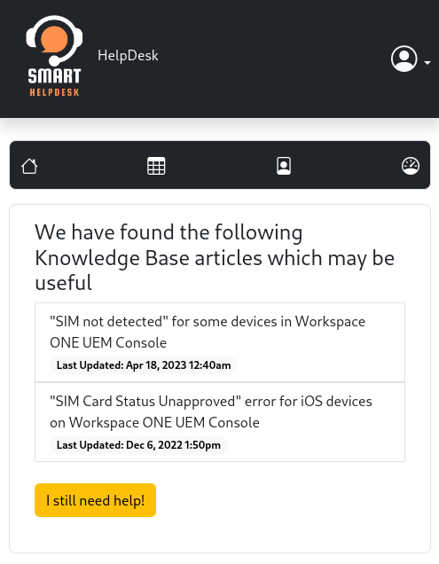
DEMO

